Slide 1
Accelerating Systems with Programmable Logic Components Lecture 03 FPGAs + Verilog I
1DT109 ASPLOC
2022 VT1-VT2
Yuan Yao, yuan.yao@it.uu.se

Slide 2
Agenda
Introduction to PLD and FPGAs
PLD
FPGA and its enablers
Know your MINIZED board
FPGA design flow
Verilog I
Introduction to Verilog
Gate-level modeling using Verilog
Data-flow/RTL-level modeling using Verilog

Slide 3
Introduction to PLD and FPGAs

Slide 4
Need for programmable logic devices (PLD)
PROM – early 70’s
EPROM – early 70’s
PLA – mid 70’s
PAL – late 70’s
EEPROM – early 80’s

Slide 5

Programmable Read-Only Memory (PROM)
Programmable Read-Only Memory (PROM) - early 70’s
Address-line used as inputs (in canonical normal form)
The value stored at an address defines the output for the specified input
One-time programmable (OTP) using fuse/anti-fuse

Slide 6
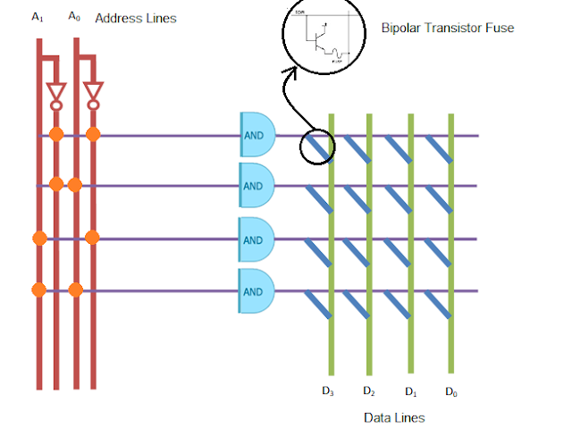
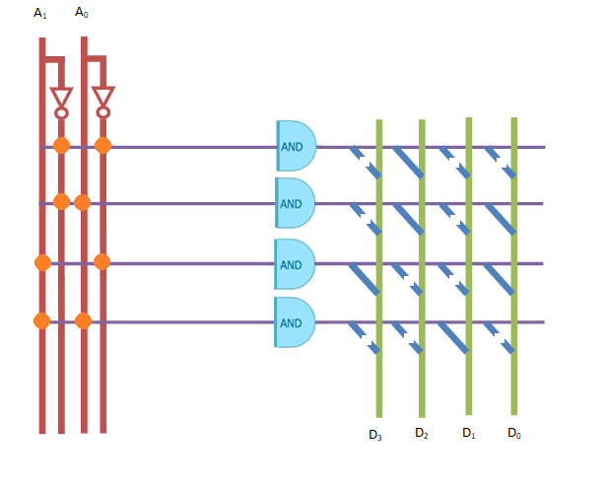
A PROM example
Address |  | Data
A₀ | A₁ | D₃ | D₂ | D₁ | D₀
0 | 0 | 0 | 1 | 0 | 0
0 | 1 | 0 | 1 | 0 | 1
1 | 0 | 1 | 0 | 0 | 1
1 | 1 | 0 | 0 | 1 | 0

Slide 7
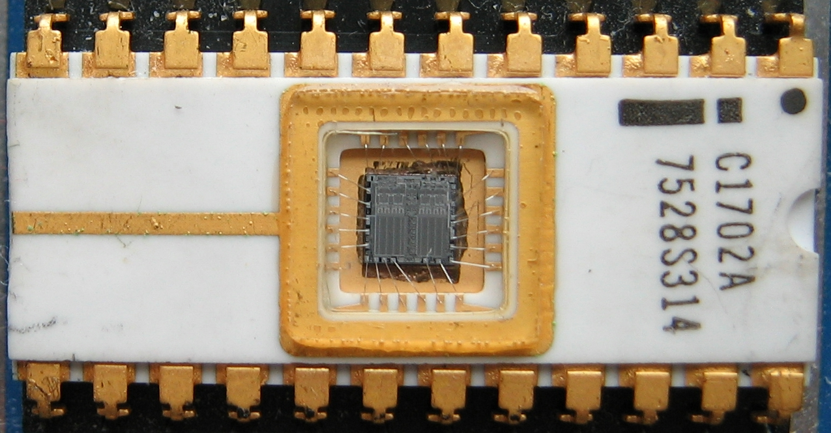
Erasable PROM (EPROM)
Erasable PROM (EPROM)
Erased by Ultraviolet light
An Intel 1702A EPROM, one of the earliest EPROM types (1971), 256 by 8 bit.
The small quartz window admits UV light for erasure.
BIOS in old PCs

Slide 8
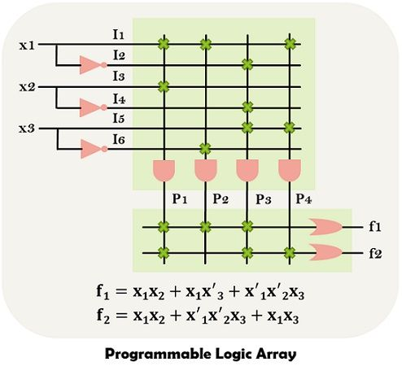
Programmable logic array (PLA)
Mid 1970’s
Programmable AND and OR gates matrices (planes)
Flexible
Support large number of functions
Expensive
Slow
Hard to program

Slide 9
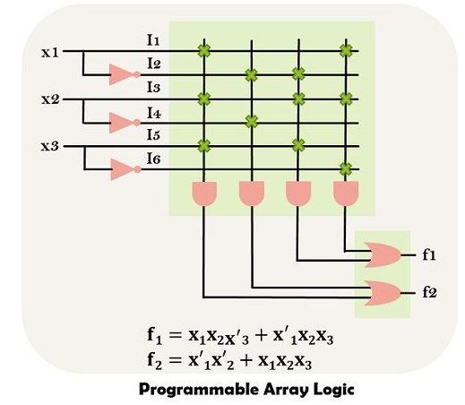
Programmable array logic (PAL)
Late 1970’s
Programmable AND and fixed OR gates
Less flexible
Support limited number of functions
Cheap
Fast
Hard to program but easier than PLA
Electronical world always welcomes cheap and fast things.

Slide 10
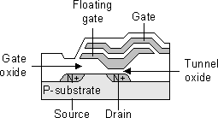
Electronically EPROM (EEPROM)
Early 80’s
Breakthrough in PLD
Metal + Oxide + Semi-conductor = MOS
Breakthrough in information storage
Flexible
Cheap
Fast
Easy to program
Metal
(Semi
nowadays)
Oxide
Semi-conductor

Slide 11




EEPROM: Write the “1” bit
(High voltage)
Can last for 10+ years!
(High voltage)

Slide 12
EEPROM: Write the “0” bit
(Low voltage)
(High voltage)

Slide 13
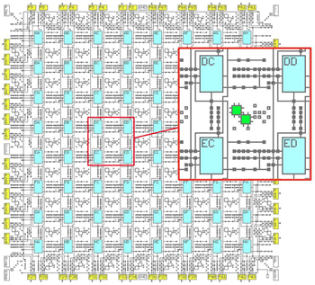
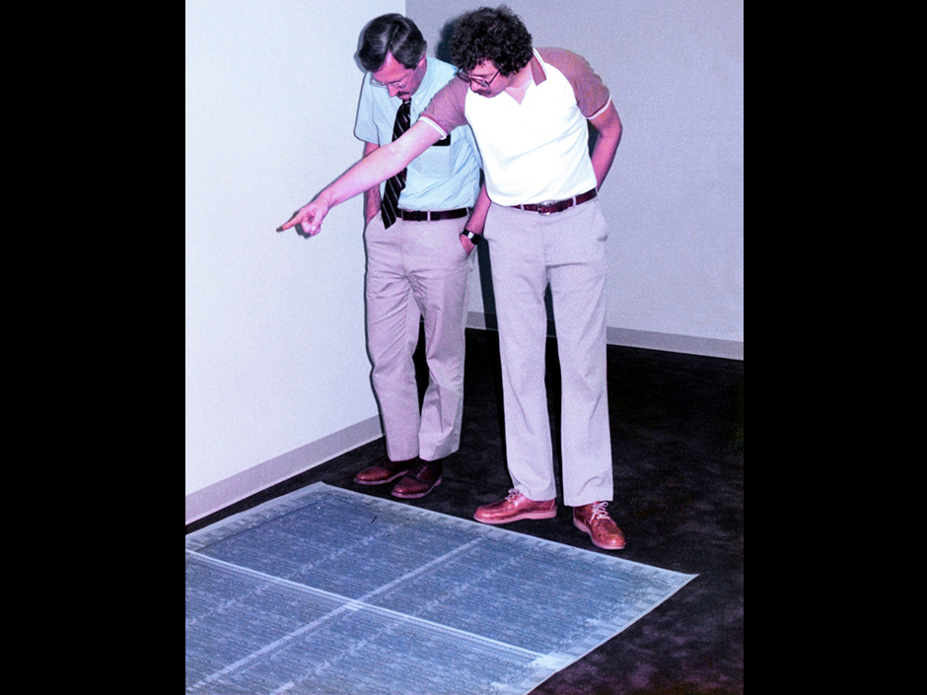
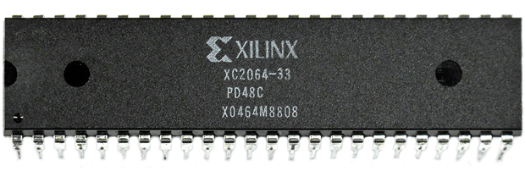
Field Programmable Gate Array (FPGA)
Mid 80’s
Xilinx co-founders Ross Freeman and Bernard Vonderschmitt invented the first commercially viable field-programmable gate array in 1985 – the XC2064.
64 logic blocks only

Slide 14
FPGA – Xilinx timeline
1985: View and configure logic and routing resources manually
“High-level” features such as Boolean expressions, K-maps, truth-tables, etc
1986: Automatic transition from schematic to physical (automatic placing & routing)
We will learn how EDA plays a routing algorithm in Lecture 7
1995: Hardware Description Languages (HDL)

Slide 15
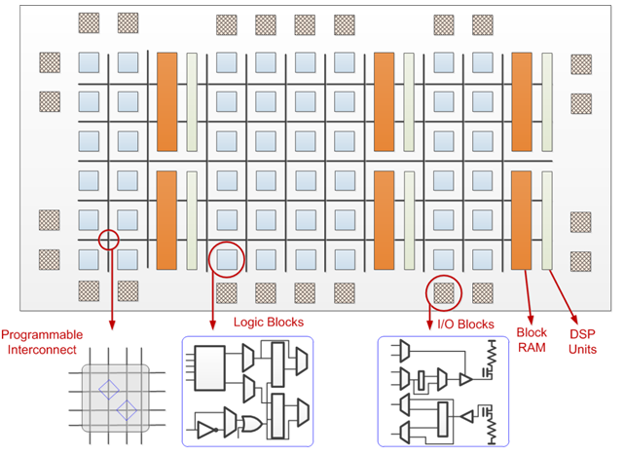
FPGA - Architecture
Overall idea: Connecting simple but distributed reconfigurable units (called logic blocks) together towards complicated functions.

Slide 16
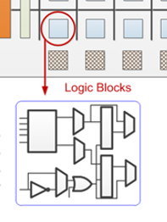
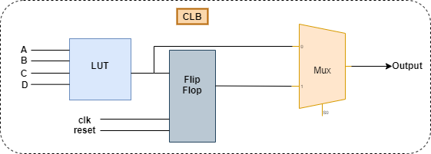
FPGA – Configurable Logic Block (CLB)
The Look Up Table (LUT) can implement any function for the input combinations.
The Flip-Flop (FF) is used for store the result of the LUT.
The Mux can implement the CLB as combinational or sequential logic.

Slide 17
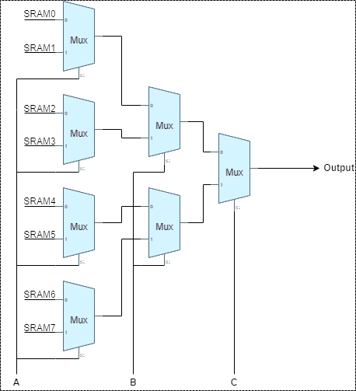
CLB - LUT
LUT
Core of the FPGA architecture.
Change the contents of the SRAM to define outputs for different input patterns.
0
1
Write into mem to reconfigure LUT.
0
0
How to implement 2-bits output functions for input A,B,C?
1
1
0
A | B | C | Output
0 | 0 | 0 | SRAM0
0 | 0 | 1 | SRAM1
0 | 1 | 0 | SRAM2
0 | 1 | 1 | SRAM3
1 | 0 | 0 | SRAM4
1 | 0 | 1 | SRAM5
1 | 1 | 0 | SRAM6
1 | 1 | 1 | SRAM7
1
0
0
1
1
0
1

Slide 18
How to implement the following function using the CLB we introduced?
A | B | C | O₁ | O₂
0 | 0 | 0 | 1 | 0
0 | 0 | 1 | 0 | 0
0 | 1 | 0 | 1 | 1
0 | 1 | 1 | 1 | 0
1 | 0 | 0 | 0 | 1
1 | 0 | 1 | 1 | 0
1 | 1 | 0 | 1 | 1
1 | 1 | 1 | 0 | 1
Using Two LUTs across Two CLBs!

Slide 19
Implement O₁ in CLB1
LUT in CLB1
A | B | C | O1 | O2
0 | 0 | 0 | 1 | 0
0 | 0 | 1 | 0 | 0
0 | 1 | 0 | 1 | 1
0 | 1 | 1 | 1 | 0
1 | 0 | 0 | 0 | 1
1 | 0 | 1 | 1 | 0
1 | 1 | 0 | 1 | 1
1 | 1 | 1 | 0 | 1
1
0
0
1
1
0
0
1
1
1
0
1
O₁
0
0
0
1
1
1
1
0
0
1

Slide 20
Implement O₂ in CLB2
LUT in CLB2
A | B | C | O1 | O2
0 | 0 | 0 | 1 | 0
0 | 0 | 1 | 0 | 0
0 | 1 | 0 | 1 | 1
0 | 1 | 1 | 1 | 0
1 | 0 | 0 | 0 | 1
1 | 0 | 1 | 1 | 0
1 | 1 | 0 | 1 | 1
1 | 1 | 1 | 0 | 1
0
0
0
1
1
0
0
0
1
1
0
1
O₂
1
0
0
0
1
1
1
0
1
1

Slide 21
Connecting CLB1 and CLB2
A B C
O₂
Connecting CLBs can only be done using the programmable interconnect, which resides outside the CLBs.
O₁
CLB1
CLB2

Slide 22
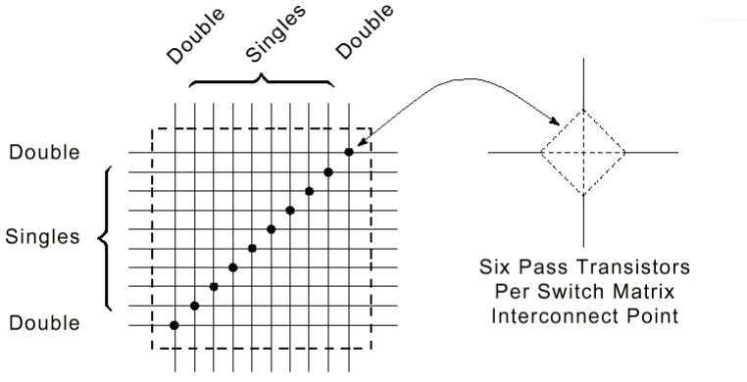
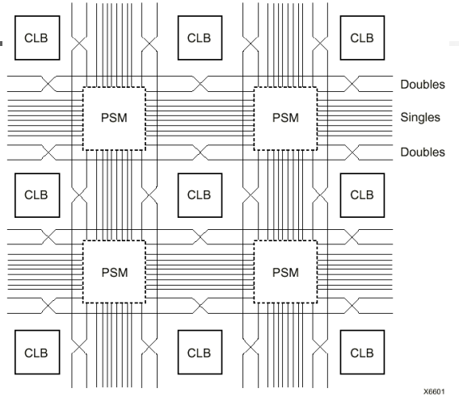
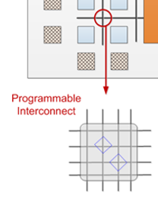
FPGA - programmable interconnect
Programmable switch matrices (PSMs)
Connecting CLBs
Are reconfigurable themselves!

Slide 23
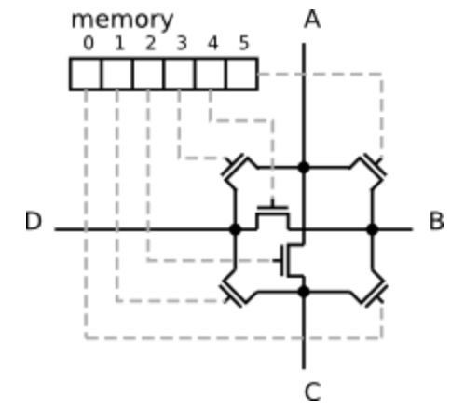
Switch matrix interconnect point
With a 6-bit memory bitfield, 6 switched can be controlled at one intersection. Hence, all connection possibilities can be achieved.
Write into mem to reconfigure connections.
M0 | M1 | M2 | M3 | M4 | M5
0 | 0 | 0 | 0 | 0 | 1 | a-b
0 | 0 | 0 | 0 | 1 | 0 | b-d
0 | 0 | 0 | 1 | 0 | 0 | a-d
0 | 0 | 1 | 0 | 0 | 0 | a-c
0 | 1 | 0 | 0 | 0 | 0 | c-d
1 | 0 | 0 | 0 | 0 | 0 | b-d

Slide 24
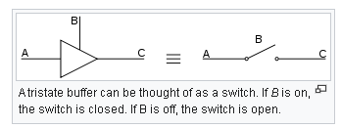
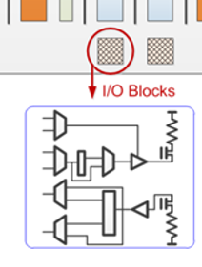
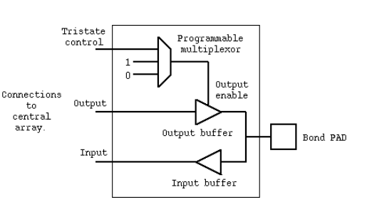
FPGA – I/O blocks
Tri-state gate.
In the output mode, the output buffer is switched on and the input buffer switched off.
In the input mode, the output buffer is switched off and the input buffer switched on.

Slide 25
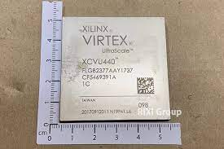
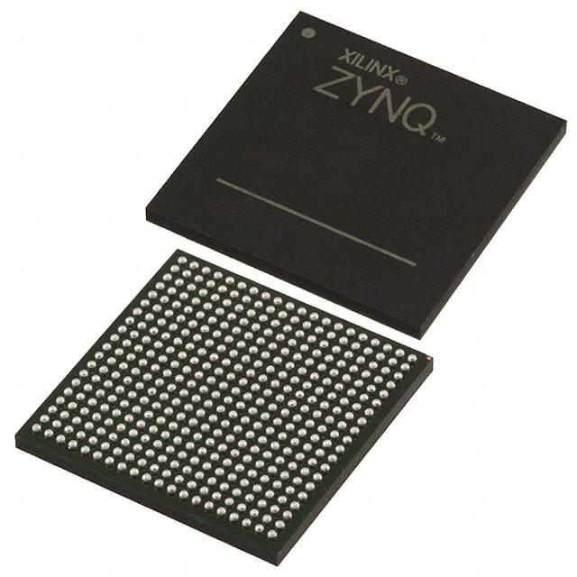
FPGA – past and now
But FPGAs are cheap and easy/quick to do implementation!
 | Xilinx XC2064 | Xilinx XCVU440 | Xilinx Zynq 7Z007S
Logic cells | 64 | 4.4M | 23K
CLB Flip-Flops | 64 | 5.0M | ??
Total Block RAM | 0 | 88.6Mb | 1.8Mb
DSP Slices | 0 | 2880 | 0
Maximum Number of I/O Pins | 38 | 1456 | 54
Differential Multi-Gigabit Transceivers | 0 | 48 | 0
Still, compared to ASICs:
FPGAs require 20-35x more area
10x more power
But 3-4x slower

Slide 26
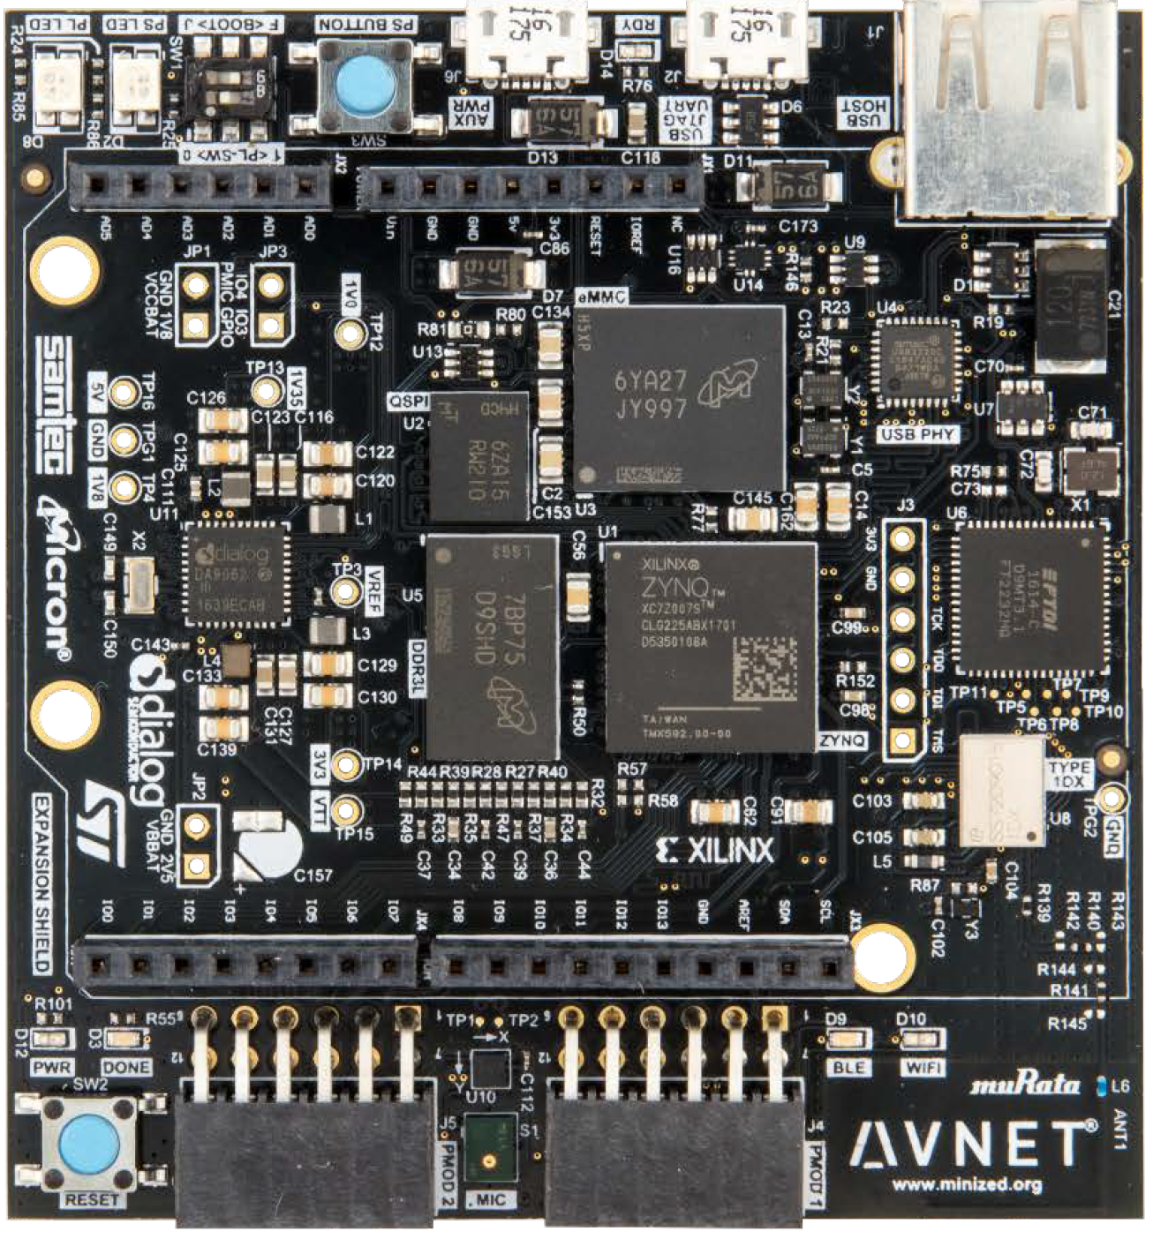
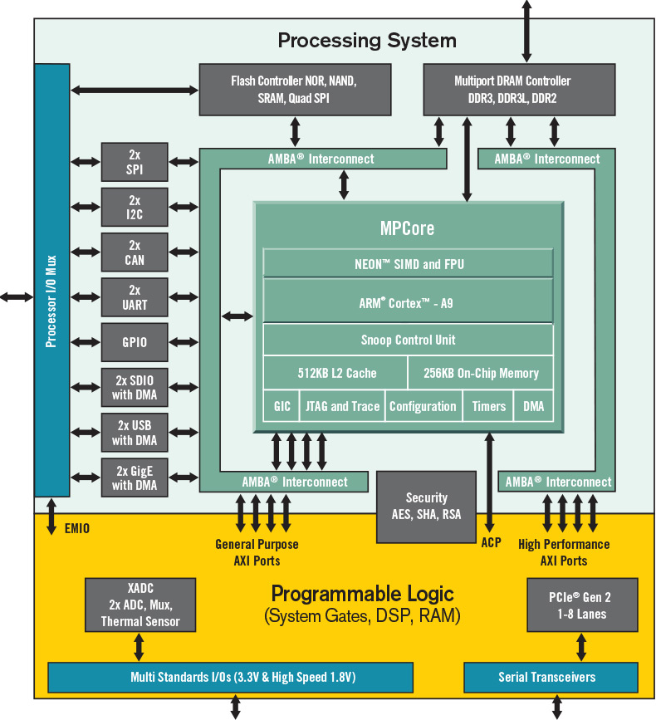
The MINIZED starter kit board
PS
Flash
Boot Loader Flash
FPGA
Mem
PL

Slide 27
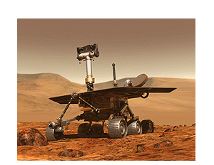
FPGA applications
Test and prototyping before ASIC
Low-volume production (military, space, etc)
Accelerators (PS+PL)
Resilience to cosmic radiation (re-programmability)
From https://forums.xilinx.com/t5/Xilinx-Xclusive-Blog/Touchdown-NASA-s-Perseverance-Rover-Lands-on-Mars-with-Xilinx/ba-p/1209732
Hello MARS...Congratulations to the amazing engineers and scientists at NASA and Jet Propulsion Labs (JPL) for a successful touchdown on the Mars Jezero Crater on February 18, 2021! We are so proud to be part of this mission with Xilinx FPGAs in the lander rover and instruments, including the vision processor to perform image processing optimization for the historic first images.

Slide 28
FPGA design flow
Today
Early Days
HDL & Graphic entry
Schematic entry
Debug
Functional verification
Design deploying to FPGA
Synthesis
Debug
Map & Place & Routing
Debug
Program FPGA
Timing verification
Debug
Test FPGA In-System
Program & System test

Slide 29
Verilog I

Slide 30
Introduction to Verilog HDL
Verilog is a Hardware Description Language (HDL)
A hardware description language is a language used to describe a digital system
Why using an HDL?
Design abstraction: HDL v.s. layout by human
Reduce cost and time to design hardware
Design reuse (IPs)

Slide 31
Brief history of HDLs
All require working with Boolean functions to some extent.
Late 70’s and early 80’s
ISP, HiLo, PALASM, CUPL, ABEL, etc
1971: Notion of “Register Transfer Level” (RTL) modeling
Mid 80’s:
Verification & Logic (Verilog) by Gateway Design Automation
C-like simulation language
1989: Cadence acquires Gateway Design Automation
1990: Verilog in public domain
Very High-speed integrated circuit hardware Description Language (VHDL) by US Department of Defense
Ada-like syntax
Used for documentation and simulation
Better abstraction!

Slide 32
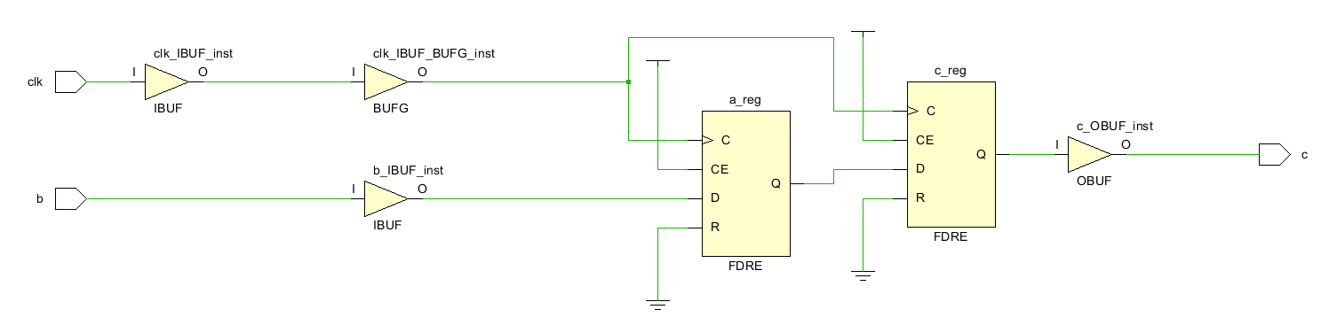
Think in hardware, not in software
Verilog is for hardware modeling/specification
The model/specification can be simulated and then synthesized into hardware
Think in hardware!
Explicit notion of time/concurrency
Data-flow
C
a=1;
b=2;
c=0;
a=b; // a=b=2
c=a; // c=a=b=2
Compiled to the following
sequential instructions:
Load %a, %b
Load %c, %a
Result: c=a=b=2
Verilog
a=1;
b=2;
c=0;
a <= b; // a=b=2
c <= a; // c=a=1
Synthesized to the following
concurrent hardware structure:
// Synthesize the design in Vivado
Result: c=1, a=b=2;
Think in hardware.
Schema come first than code.

Slide 33
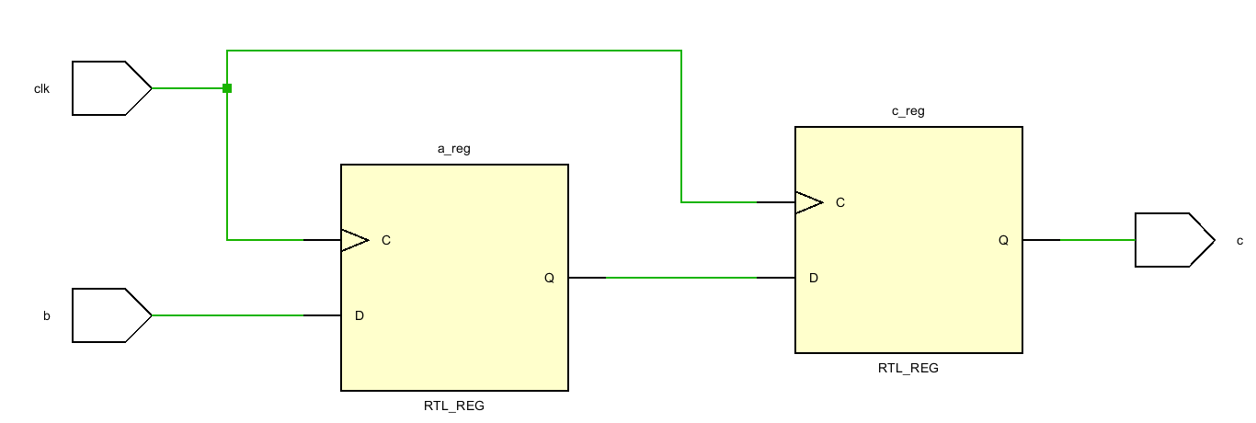
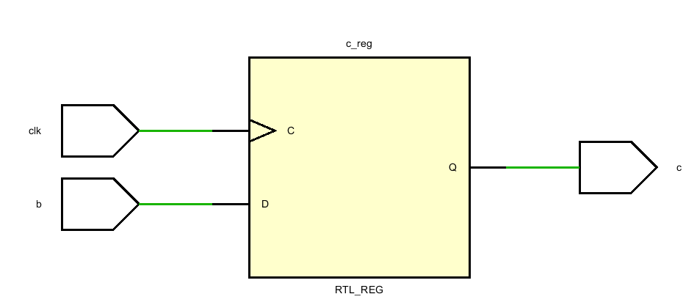
Demo 1
Blocking/non-blocking assignments.
Verilog
//demo_1
a=1;
b=2;
c=0;
a <= b; // a=b=2
c <= a; // c=a=1
Synthesized to the following
concurrent hardware structure:
// Synthesize the design in Vivado
Result: c=1, a=b=2;
Verilog
//demo_2
a=1;
b=2;
c=0;
a = b; // a=b=2
c = a; // c=a=2
Synthesized to the following
concurrent hardware structure:
// Synthesize the design in Vivado
Result: c=a=b=2;

Slide 34
Verilog supports various levels of abstraction
Less detail (relying more on EDA)
Faster simulation
Shorter time-to-market
Less optimization
Behavioral model
Data flow model or register transfer level (RTL) model
Gate level model
Switch level model or transistor level model
More detail (relying less on EDA)
Slower simulation
Longer time-to-market
More optimization

Slide 35
In more detail, verilog can model…
Constructs used only for simulation
Gate delays
Signal strength
Verilog procedural interface (VPI)
Facilities for debugging/verification
...
Constructs used for both simulation and synthesis
Registers
Wires
Assignments
Operators
…
Use synthesizable constructs for HW implementation.
Use non-synthesizable constructs for verification/debugging.

Slide 36
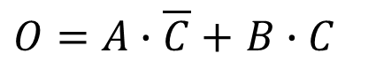
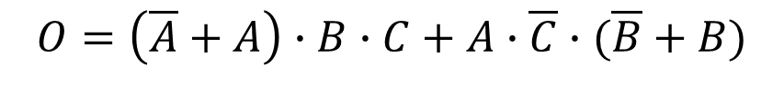
Verilog example (digital design recap)
Implement the following function use Verilog
A | B | C | O
0 | 0 | 0 | 0
0 | 0 | 1 | 0
0 | 1 | 0 | 0
0 | 1 | 1 | 1
1 | 0 | 0 | 1
1 | 0 | 1 | 0
1 | 1 | 0 | 1
1 | 1 | 1 | 1
Let us start with gate-level modeling.
$$O=\overline{A}∙B∙C+A∙\overline{B}∙\overline{C}+A∙B∙\overline{C}+A∙B∙C$$
$$O=\overline{A}∙B∙C+A∙B∙C+A∙\overline{B}∙\overline{C}+A∙B∙\overline{C}$$
$$O=\left(\overline{A}+A\right)∙B∙C+A∙\overline{C}∙(\overline{B}+B)$$
$O=A∙\overline{C}+$ $B∙C$

Slide 37
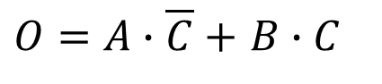
Step 1 – Schema comes first than code
my_module
A
And1
B
Not1
Or1
O
And2
C
$O=A∙\overline{C}+$ $B∙C$

Slide 38
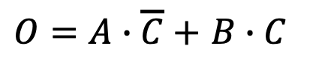
Step 2 – Model the module using gale-level Verilog
module my_module(A, B, C, O);
input A, B, C;
output O;
not Not1();
and And1();
and And2();
or Or1();
endmodule
$O=A∙\overline{C}+$ $B∙C$
input/output
my_module
declaration
sub module
my_module
A
And1
B
Not1
Gate primitives provided in libraries:
GateName (out, in1, in2, in3, ... )
Or1
O
And2
C

Slide 39
Step 3 – connecting submodules up
module my_module(A, B, C, O);
input A, B, C;
output O;
not Not1(.in1(C));
and And1(.in1(A));
and And2(.in1(B), .in2(C));
or Or1(.out(O));
endmodule
$O=A∙\overline{C}+$ $B∙C$
module my_module(A, B, C, O);
input A, B, C;
output O;
not Not1();
and And1();
and And2();
or Or1();
endmodule
Gate primitives provided in libraries:
GateName (out, in1, in2, in3, ... )
my_module
A
And1
B
Not1
Or1
O
And2
C

Slide 40
Step 3 – connecting submodules up
module my_module(A, B, C, O);
input A, B, C;
output O;
wire w_not, w_and1, w_and2;
not Not1(.in1(C));
and And1(.in1(A));
and And2(.in1(B), .in2(C));
or Or1(.out(O));
endmodule
$O=A∙\overline{C}+$ $B∙C$
Gate primitives provided in libraries:
GateName (out, in1, in2, in3, ... )
internal signal
my_module
A
And1
Wires are used for connecting different elements. They can be treated as physical wires.
B
Not1
Or1
O
And2
C

Slide 41
Step 3 – connecting submodules up
module my_module(A, B, C, O);
input A, B, C;
output O;
wire w_not, w_and1, w_and2;
not Not1(.out(w_not), .in1(C));
and And1(.in1(A), .in2(w_not));
and And2(.in1(B), .in2(C));
or Or1(.out(O));
endmodule
$O=A∙\overline{C}+$ $B∙C$
Gate primitives provided in libraries:
GateName (out, in1, in2, in3, ... )
internal signal
my_module
A
And1
Not1
w_not
B
Or1
O
And2
C

Slide 42
Step 3 – connecting submodules up
module my_module(A, B, C, O);
input A, B, C;
output O;
wire w_not, w_and1, w_and2;
not Not1(.out(w_not), .in1(C));
and And1(.out(w_and1), .in1(A), .in2(w_not));
and And2(.in1(B), .in2(C));
or Or1(.out(O), .in1(w_and1));
endmodule
$O=A∙\overline{C}+$ $B∙C$
Gate primitives provided in libraries:
GateName (out, in1, in2, in3, ... )
internal signal
my_module
A
And1
w_and1
B
Not1
Or1
O
And2
C

Slide 43
Step 3 – connecting submodules up
module my_module(A, B, C, O);
input A, B, C;
output O;
wire w_not, w_and1, w_and2;
not Not1(.out(w_not), .in1(C));
and And1(.out(w_and1), .in1(A), .in2(w_not));
and And2(.out(w_and2), .in1(B), .in2(C));
or Or1(.out(O), .in1(w_and1), in2(2_and2));
endmodule
$O=A∙\overline{C}+$ $B∙C$
Gate primitives provided in libraries:
GateName (out, in1, in2, in3, ... )
internal signal
A lot of time on port mapping.
Solution 1
my_module
A
And1
B
Not1
Or1
O
And2
C
w_and2

Slide 44
Port mapping by name vs by order
By name
By order
You can shuffle input/output order in named mapping, but not in order mapping.
module my_module(A, B, C, O);
input A, B, C;
output O;
wire w_not, w_and1, w_and2;
not Not1(.out(w_not), .in1(C));
and And1(.out(w_and1), .in1(A), .in2(w_not));
and And2(.out(w_and2), .in1(B), .in2(C));
or Or1(.out(O), .in1(w_and1), in2(2_and2));
endmodule
module my_module(A, B, C, O);
input A, B, C;
output O;
wire w_not, w_and1, w_and2;
not Not1(w_not, C);
and And1(w_and1, A, w_not);
and And2(w_and2, B, C);
or Or1(O, w_and1, 2_and2);
endmodule
Solution 2

Slide 45
Any other way to do my_module?
Less detail (relying more on EDA)
Faster simulation
Shorter time-to-market
Less optimization
Behavioral model
Data flow model or register transfer level (RTL) model
Gate level model
Switch level model or transistor level model
Let’s do my_module in data-flow level.
More detail (relying less on EDA)
Slower simulation
Longer time-to-market
More optimization

Slide 46
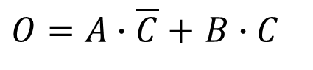
Data-flow level modeling
Step 1 – Schema comes first than code
my_module
A
And1
B
Not1
Or1
O
And2
C
$O=A∙\overline{C}+$ $B∙C$

Slide 47
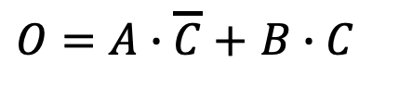
Step 2 – Model the module using data-flow level Verilog
Signals of type wire requires the continuous assignment of a value. In Verilog, this concept is realized by the assign statement where any wire can be driven continuously with a value.
module my_module(A, B, C, O);
input A, B, C;
output O;
wire w_not, w_and1, w_and2;
assign w_not = ~C;
assign w_and1 = A & w_not;
assign w_and2 = B & C;
assign O = w_and1 | w_and2;
endmodule
Solution 3
my_module
A
And1
w_and1
B
Not1
w_not
Or1
O
And2
C
w_and2
$O=A∙\overline{C}+$ $B∙C$

Slide 48
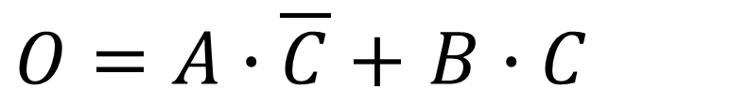
Step 2 – Model the module using data-flow level Verilog
module my_module(A, B, C, O);
input A, B, C;
output O;
assign O = (A & ~C) | (B & C);
endmodule
$O=A∙\overline{C}+$ $B∙C$
Solution 4

Slide 49
Step 2 – Model the module using data-flow level Verilog
module my_module(A, B, C, O);
input A, B, C;
output O;
assign O = (C) ? B : A;
endmodule
$O=A∙\overline{C}+$ $B∙C$
my_module is actually a way to implement multiplexer using gates.
Solution 5
A
MUX
O
B
C

Slide 50
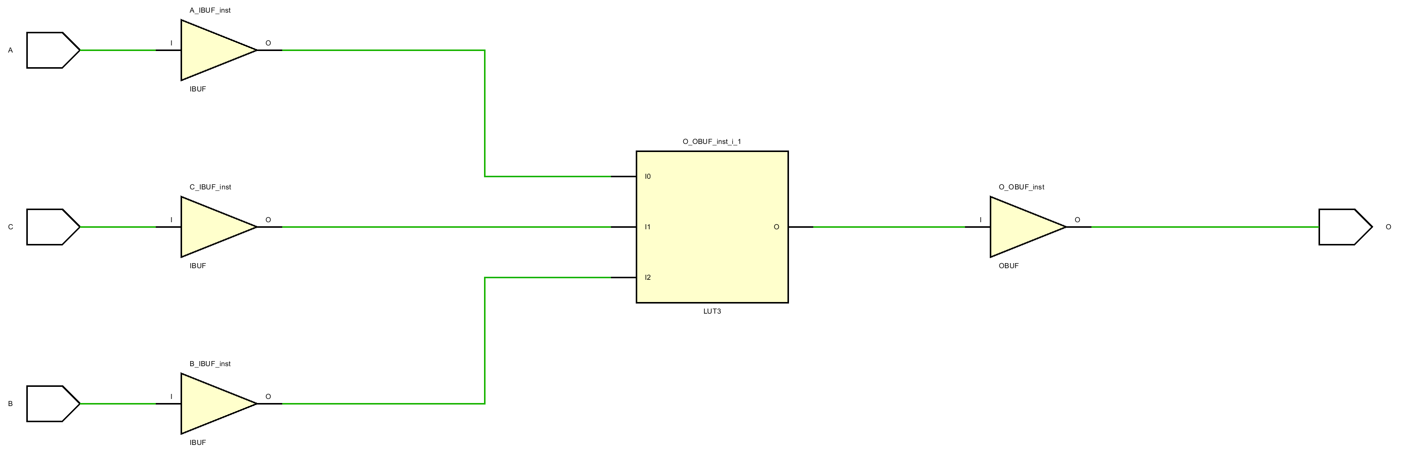
EDA Synthesis
The five solutions differ in coding style, complicity, readability, conciseness, etc
Choose wisely according to your project’s/teammates’ needs
All the four solutions yield the same synthesis result in Vivado.
Unlike in ASIC, you cannot see the gates but only LUTs in FPGA synthesis.
If you like, you can still see the “gates” under RTL analysis -> schematic.

Slide 51

Questions?

